Slide 1
CS6790 Paper Presentation 27 April 2018
Paper : Building Rome in a Day, Sameer Agarwal, Noah Snavely, Ian Simon, Steven M. Seitz, Richard Szeliski
Divya K Raman, Sharath Girish

Slide 2
Abstract
Matching and reconstructing 3D scenes from large collections of photographs found on the Internet.
Novel parallel distributed matching and reconstruction
Scales gracefully with size of problem as well as compute power available.
Different algorithms experimented at each stage of the pipeline.

Slide 3
Pipeline
Pre-processing/ Feature extraction
Image matching
Vocabulary tree proposals
Verification and detailed matching
Merging components
Query expansion
Track generation
Geometric estimation: Bundle Adjustment

Slide 4
Pre-processing and feature extraction
Cluster of nodes (computers) with a master node is used.
Images distributed to each node based on demand.
Valid image files are identified. Images larger than 2 Mega pixels are down sampled, scaling focal lengths, if present, accordingly.
SIFT features are extracted and stored with the corresponding images in each node.

Slide 5
Image matching
Photometric matching of interest points and geometric verification using a robust estimate of the fundamental matrix.
SIFT features of one image inserted in a k-d tree and other image used as query.
Matches verified using RANSAC estimation of fundamental matrix.
Impractical to match all pairs of images in the corpus, as a majority don't match. Also requires lots of network transfers.
Multi-stage matching scheme is used which maximizes parallelism.

Slide 6
Vocabulary tree proposals
A TF vector is obtained for each image and a document frequency vector (DF) for the corpus.
Aggregating these vectors, TFIDF matrices obtained for each node.
Matrices are broadcast across all nodes so that for each image, top scoring k₁+k₂ images are identified.
k₁ images used for initial verification stage and k₂ images later on for connecting components.

Slide 7
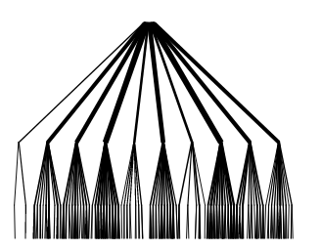
Vocabulary tree proposals
Feature descriptors quantized in a hierarchical k-means tree.
Aggregating the quantizations for all features in the image gives a term frequency (TF) vector for the image. This can be done as follows.
Assign weight w_{i} to node i in vocabulary tree.
q_{i} = n_{i} w_{i} .
w_{i} is typically set by entropy weighting like
w_{i} = ln(N/N_{i}) .
This results in a TF-IDF scheme

Slide 8
Verification and detailed matching
Images need to be distributed across the network so that number of matches across nodes should be minimized.
First idea involved building a graph connecting image pairs which need to be verified. Graph partitioned into as many pieces as there are compute nodes.
Second idea over-partitioned the graph and send to nodes on demand. Partitioning itself becomes bottleneck when graph is large.
Greedy bin packing algorithm used for best results. Scheduling of jobs is the bottleneck.

Slide 9
Verification and detailed matching
After assigning images to nodes optimally, verification is done.
Photometric matching between feature descriptors and robust estimation of fundamental matrix for each matched image pair.
If there is sufficient angle between the viewing directions and number of matches above a threshold, full Euclidean 2-view reconstruction done and stored for a later stage.

Slide 10
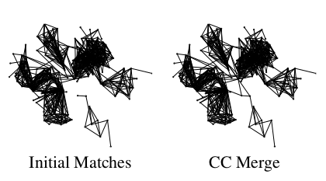
Merging connected components
Images with no verified match in top k₁ proposed matches are discarded.
k₂ proposals from the vocabulary tree used to minimize number of connected components.
Image pairs which run across different components are verified.
In figure, the 2 connected components get merged into one after this step.

Slide 11
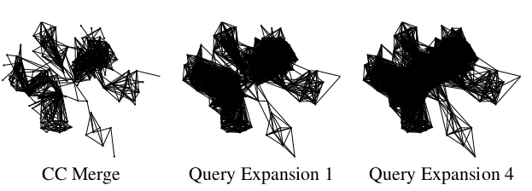
Query expansion
For document retrieval, documents matching the query document are found and these documents are in turn used as queries.
In essence, for the image match graph, if images I and j are connected and j and k are also connected, detailed match is performed between i and k.
Process repeated a fixed number of times.
Helps in rapidly expanding density of component connections.

Slide 12
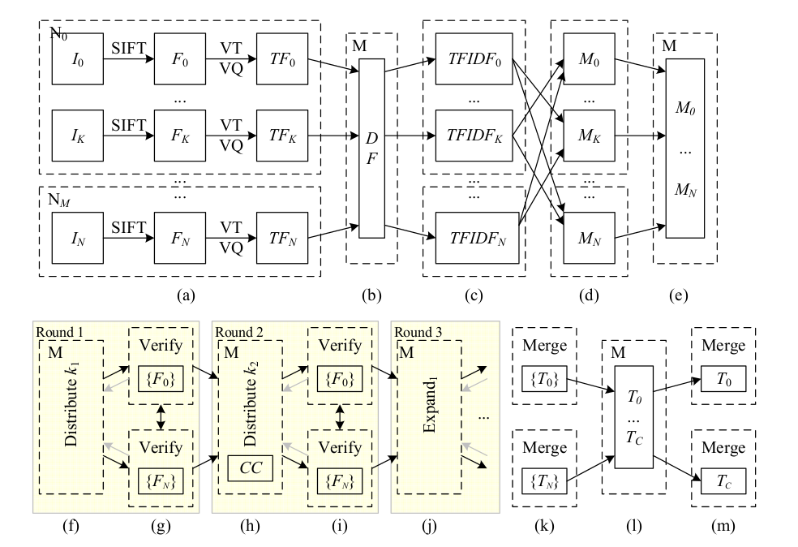
Pipeline

Slide 13
Track Generation
Final step of matching process; combine all pairwise matching information to generate consistent tracks across images.
The algorithm finds and labels all connected components in the graph of individual feature matches.
Two stages –
Each node generates tracks from all the matching data it has locally
This is then gathered at the mastered node; broadcast over the network to all nodes

Slide 14
Tracks for each connected component of the match graph can be processed independently.
The track generation then proceeds with each compute node being assigned a connected component for which the tracks need to be produced.
Inconsistent tracks can be generated as we merge tracks based on shared features- offending points discarded.

Slide 15
Getting back the 2D point information
After the tracks have been generated, 2D coordinates of the feature points are extracted from the corresponding image feature files.
2 steps:
Given the per-component tracks, each node extracts the feature point coordinates and the point colors from the SIFT and image ﬁles that it owns.
This data is gathered and broadcast over the network, where it is processed on a per connected component basis.

Slide 16
Geometric estimation
Here, we recover a pose for every camera and a 3D position for every track by running SfM on every connected component of the match graph.
Incremental Approach of SfM:
Start with a small reconstruction, grow few images at a time, triangulate new points, iteratively do bundle adjustment which is a non linear least squares optimisation to minimise reprojection error.
Not possible in this algorithm due to the scale of the problem. Also, all images contribute more or less equally to the coverage and accuracy of the reconstruction which is not true in collection of photos from the internet.

Slide 17
Algorithm used in this paper:
The algorithm finds and reconstruct a minimal subset of photographs that capture the essential connectivity of the match graph and the geometry of the scene.
Skeletal sets algorithm, which computes a spanning set of photographs that preserves important connectivity information in the image graph(such as large loops).
Two-frame reconstruction computed for each pair of matching images with known focal lengths.
These pairwise reconstruction are computed as part of the parallel matching process.

Slide 18
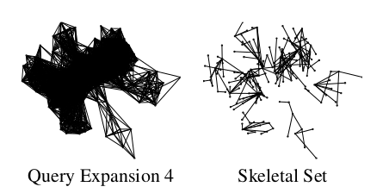
Once a skeletal set is computed, the SfM parameters of each resulting component using the incremental algorithm.
Remaining images are added back using pose estimation, triangulate all remaining points, and then a ﬁnal bundle adjustment to reﬁne the SfM estimates is done.
The size of the SfM problem reduced down to the skeletal set

Slide 19
Bundle Adjustment
Primary bottleneck of the algorithm.
Variant of Sparse Bundle Adjustment(SBA) proposed by Lourakis & Argyros is the algorithm used.
Original Algorithm:
Uses Schur complement trick to reduce the size of the linear system (also known as the normal equations) that needs to be solved in each iteration of the Levenberg-Marquardt(LM)algorithm
size of this linear system - depends on the 3D point and the camera parameters
size of the Schur complement - depends on the camera parameters.
SBA uses a dense Cholesky factorization to factor and solve the resulting reduced linear system. Since the number of 3D points in a typical SfM problem is usually two orders of magnitude or more larger than the number of cameras, this leads to substantial savings.

Slide 20

Levenberg–Marquardt algorithm
Non linear least-squares minimisation problem
m data pairs (x,y); parameter β, curve f(x, β), sum of the squares of the deviations S(β) is minimized:
Iterative procedure
Start with initial guess for β.
Care needs to be taken if objective function is not convex.

Slide 21

Every iterative step:
Parameter β replaced with β+δ. To determine δ, the following linearization is used:
where
At its minimum, the sum of squared deviation S(β) has zero gradient wrt β.
LM can be seen as a blend of gradient descent and gauss-newton iteration.

Slide 22
Issues
Works for small to moderate sized problems, but for large problems with thousands of images, computing the dense Cholesky factorization of the Schur complement consumes too much time.
For large problems however, the Schur complement itself is quite sparse (a 3D point is usually visible in only a few cameras), the fact can be used to improve efficiency.

Slide 23
Variant of SBA
High performance
Depending upon the size of the problem, a choice is made between a truncated and an exact step LM algorithm.
In the ﬁrst case, a block diagonal preconditioned conjugate gradient method is used to solve approximately the normal equations.
Conjugate gradient method : algorithm for the numerical solution of particular systems of linear equations, namely those whose matrix is symmetric and positive-definite
A block diagonal matrix, also called a diagonal block matrix, is a square diagonal matrix in which the diagonal elements are square matrices of any size (possibly even ), and the off-diagonal elements are 0.

Slide 24
preconditioning is the application of a transformation, called the preconditioner, that conditions a given problem into a form that is more suitable for numerical solving methods.
Iterative algorithm
applicable to sparse systems that are too large to be handled by a direct implementation or other direct methods such as the Cholesky decomposition.

Slide 25
In the second case, CHOLMOD, a sparse direct method for computing Cholesky factorization is used to exactly solve the normal equations via the Schur complement trick.
Comparison: The ﬁrst algorithm has low time complexity per iteration, but uses more LM iterations, while the second one converges faster at the cost of more time and memory per iteration.
Result: The resulting code uses signiﬁcantly less memory than SBA and runs up to an order of magnitude faster. The exact runtime and memory savings depend upon the sparsity structure of the linear system involved.

Slide 26
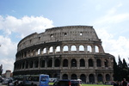
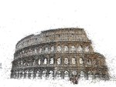
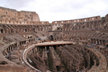
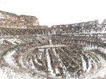
Results: Rome
# Images | # Cores | Match Time | Reconstruction Time | Largest Component
150,000 | 496 | 13 Hours | 8 Hours | 2,106

Slide 27
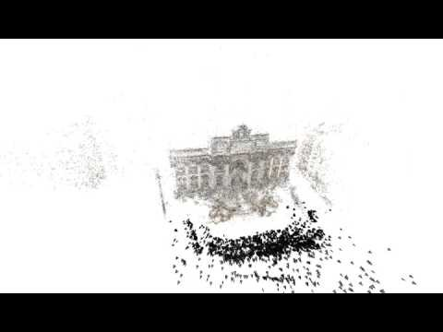
Trevi Fountain

Slide 28
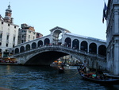
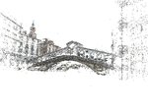
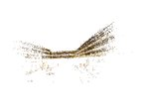
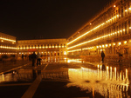
Venice: Largest image collection so far experimented
# Images | # Cores | Match Time | Reconstruction Time | Largest Component
250,000 | 496 | 27 Hours | 38 Hours | 14,079

Slide 29
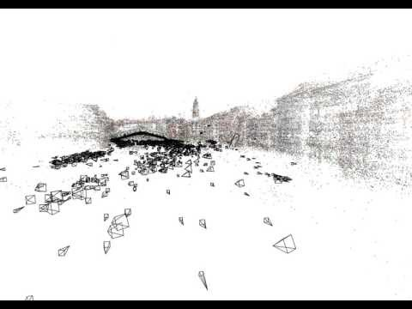
Grand canal

Slide 30
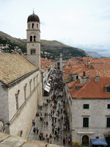
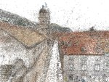
Results: Dubrovnik
# Images | # Cores | Match Time | Reconstruction Time | Largest Component
57,845 | 352 | 5 Hours | 17.5 Hours | 4585

Slide 31
Few Observations:
Same vocabulary tree used in all experiments - trained off-line on 1,918,101 features extracted from 20,000 images of Rome.
Tree with a branching factor of 10 and a total of 136,091 vertices was trained. For each image, vocabulary tree used to ﬁnd the top 20 matching images. The top k1 = 10matches were used in the ﬁrst veriﬁcation stage, and the next k2 = 10 matches were used in the second component matching stage.
Four rounds of query expansion were done after which it was found to converge.

Slide 32
SfM time for Dubrovnik is much more than for Rome, and is almost the same as Venice, both which is are much larger data sets. The reason lies in how the datasets are structured.
Rome and Venice data sets: essentially a collection of landmarks, which at large scale have a simple geometry and visibility structure. However, the largest connected component in Dubrovnik on the other hand captures the entire old city. With its narrow alley ways, complex visibility and widely varying view points, it is a much more complicated reconstruction problem.

Slide 33
Limitations and Future work
The track generation, skeletal sets, and reconstruction algorithms are all operating on the level of connected components. This means that the largest few components completely dominate these stages.
Reconstruction uses multi threading(single set of code used by several processors at different stages of execution) when solving BA problem, useful but not a scalable solution – can take too much time and memory depending on the connectivity pattern of the match graph.
The key reason reconstruction of these large image collections is possible is the large amount of redundancy present in Internet collections, which the skeletal sets algorithm exploits.

Slide 34
Current Work: ways of parallelizing all three of these steps, with particular emphasis on the SfM system.
Algorithm is designed with batch operation in mind. A more challenging problem is to start with the output of this system and to add more images as they become available.

Slide 35
References
1. Paper: Building Rome in a Day, Sameer Agarwal, Noah Snavely, Ian Simon, Steven M. Seitz, Richard Szeliski
2. Website: http://grail.cs.washington.edu/rome/
3. https://en.wikipedia.org/wiki/Levenberg–Marquardt_algorithm
4. http://ananth.in/docs/lmtut.pdf

